Slide 1
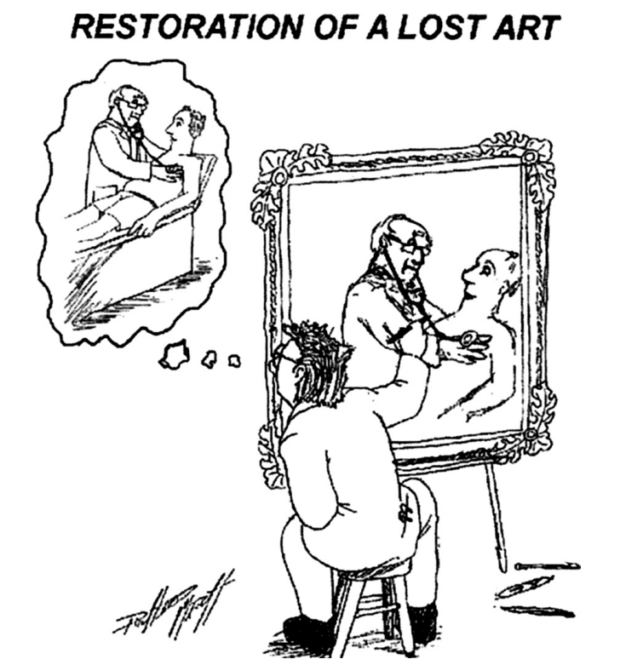
Dynamic Auscultation
Presented by : Dr AJMAL
Chaired by : Dr SAJEER K T

Slide 2
References:
BRAUNWALD’S HEART DISEASE – TWELFTH EDITION
ESSENTIALS OF CARDIAC PHYSICAL DIAGNOSIS – JONATHAN ABRAMS
CARDIAC AUSCULTATION: REDISCOVERING THE LOST ART MICHAEL A. CHIZNER, MD
Essentials of bedside cardiology by JULES CONSTANT
CLINICAL EXAMINATION IN CARDIOLOGY – B N VIJAY RAGHAWA RAO
CLINICAL METHODS IN CARDIOLOGY – B SOMA RAJU

Slide 3
What is dynamic auscultation
Technique of altering the circulatory dynamics by means of variety of physiological and pharmacological maneuvers and determining their effects on heart sounds and murmers.
Influence of Physiological and pharmacological maneuvers on auscultatory events
1)Respiratory variation
2)Postural changes(Standing, Supine, Squatting, passive leg raising)
3)Valsalva maneuver and Mullers Maneuver Physiological
4)Isometric exercise
5)Cycle length Changes-AF/Post VPC
6)Vasoactive agents-Amylnitrate, Methoxamine,Phenylephrine→Pharmacological

Slide 4
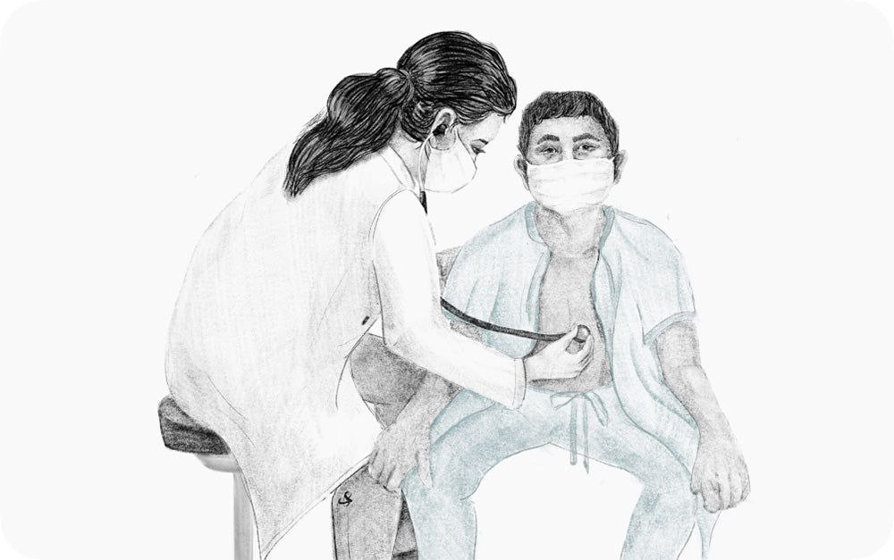
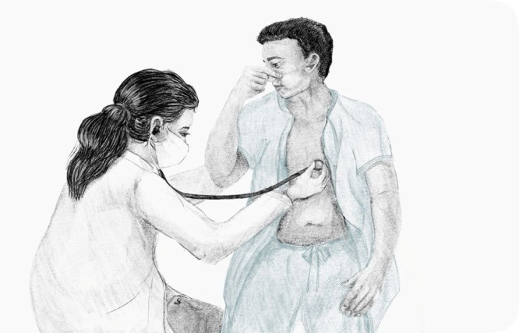
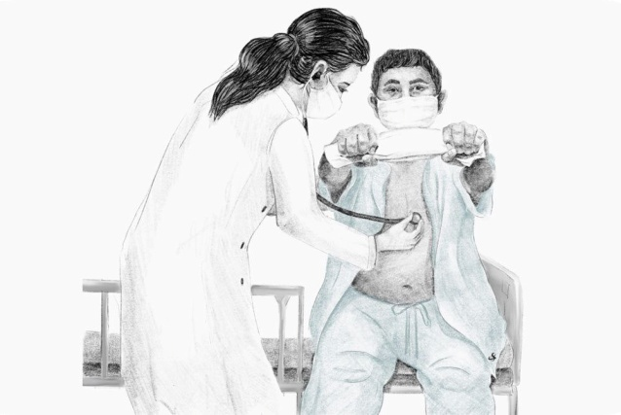
Proper assessment requires
Good stethoscope
Quiet room
Co operative patient
Bare chest
Intact autonomic function and normovolemia
Knowledge about the maneuver and the changes expected
Dynamic auscultation is best performed when the patient is in Sinus Rhythm
Auscultation should be done for a few cycles with each maneuver
For Ex: Squatting-10cycles F/B Standing 10 Cycles

Slide 5
REFLEX | RECEPTOR | RECEPTOR LOCATION | STIMULUS | SYMPATHETIC ACTIVITY | PARA SYMPATHETIC ACTIVITY
Arterial Baroreceptor | Mechano receptor | Internal carotids and Aortic arch | Increased arterial pressure | Decreased | Increased
Bainbridge | Mechano receptor | Veno atrial | Increased venous return | Increased | Decreased
BARORECEPTOR FEEDBACK LOOP:
Sudden decrease in arterial pressure (For Ex: abrupt standing from supine position)
It Decreases Baroreceptor firing → activating sympathetic nerves → Inhibiting parasympathetic nerves.
This increases cardiac output and SVR which restores normal arterial pressure

Slide 6
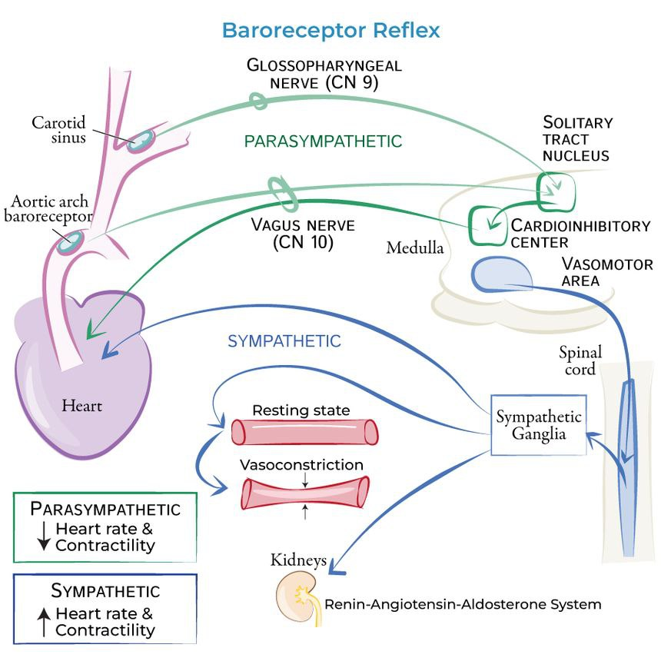
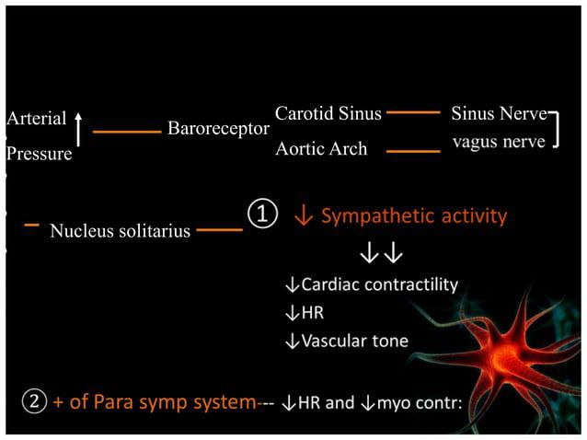

Slide 8
Changes during Dynamic auscultation depends up on
1)Hemodynamic-
.Heart rate
.Volume(Coming and going)
.Flow rate –(depends up on HR, resistance, force of contraction)
(Increase in flow rate=4times increase in gradient)
.Vascular resistance
.Force of contraction
2)Autonomic nervous system
3)Underlying Heart disease

Slide 9
Change in Ventricular volume/Stroke volume is the one on which dynamic auscultation mostly depend up on.
No change in Volume/preload → No change in force of contraction
That is why in situations were you cant modify Ventricular volume-Dynamic auscultation has no much role
Ex: Severe CHF, Consrtictive pericarditis, ASD
If patient is in florid heart failure- Avoid Complex dynamic auscultation

Slide 10
Respiratory Variations
Pontain in 1866 was first to note splitting of S2 with respiratory variation
In 1954, Leatham brought Potain's observations in to clinical attention
INSPIRATION
Negative Intrathoracic pressure→Sucks blood in to Rt Heart
Venacava→Rt Atrial Gradient Increases
Cardiac Chambers(RA) are intrathoracic but venacava are extrathoracic
Rt atrial pressure decrease but venacaval pressure doesnot change
Venous return to Rt heart Increase→Augments right sided events
Intensity of murmer α Flow rate and Square Root of Gradient

Slide 11
When flow to RV increases
1)RV force of contraction increases
2)Prolongs RV ejection time
3)Dilatation of tricuspid annulus
Various MRI studies have proved Inspiratory dilatation of TA
In TR→During inspiration Effective Regurgitant Orrifice increase
Best explanation for Increase in TR murmer during inspiration

Slide 12
What is happening to Left side?
Both Chambers(LA) and Pulmonary veins are intrathoracic
Fall in intathoracic pressures are equally transmitted to LA and PV
So PV-LA gradient doesnot change
But instead→Due to expanded lung→ Blood pools in Pulmonary vasculature
RV filled with blood→Pericardial constraint→IVS slightly shift to Lt side
Reduced LV preload and Stroke volume→ Reflex tachycardia
Attenuates left sided events (Except MVP and HOCM)

Slide 13
Effect of respiration on Heart sounds
During expiration, A2 and P2 are separated by an interval of 30 ms, so these are heard as a single sound (S2).
While during inspiration, separation of the two components (A2, P2) increases to 40–50ms, which makes them separately audible.
Reason For a delayed P2 in inspiration
Prolongation of pulmonary hangout interval
Prolongation of RV ejection time

Slide 14
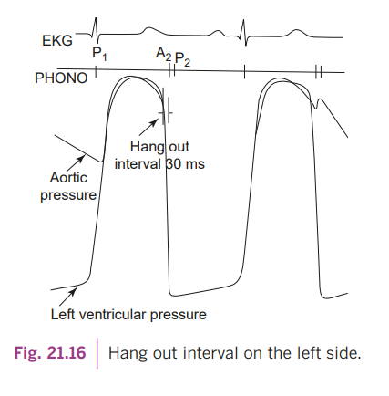
Concept of Hangout Interval

Slide 15
The semilunar valves are expected to close at the point of pressure cross over.
(LV pressure falls lower than aortic pressure, RV pressure falls lower than PAP).
However in reality these valves close slightly later (at the incisura of aorta and pulmonary artery pressure tracing).
This time interval from the crossover of the pressures to the actual closer (occurrence of A2 and P2) is called hang out interval.
Duration of hang out interval depends upon the pressures in the arteries, vascular resistance, distensibility and recoil of the arterial system.
Due to higher pressure and less distensibility, the hang out interval on the aortic side is less than that of on the pulmonary side.
During inspiration- There is decrease in resistance and increase in capacitance of the pulmonary vascular bed → increase in pulmonary artery hang out interval.

Slide 16
Pulmonary ejection sound
Pulmonary valvular ejection sound is best heard during expiration, and its intensity decreases with inspiration.
Inspiratory increase of venous return and RV stroke volume leads to the elevation of RVEDP beyond the pulmonary artery diastolic pressure (PADP).
This cause premature opening of the pulmonary valve in diastole itself and less upward motion of the valve leaflets resulting in the decreased intensity of ejection sound.

Slide 17
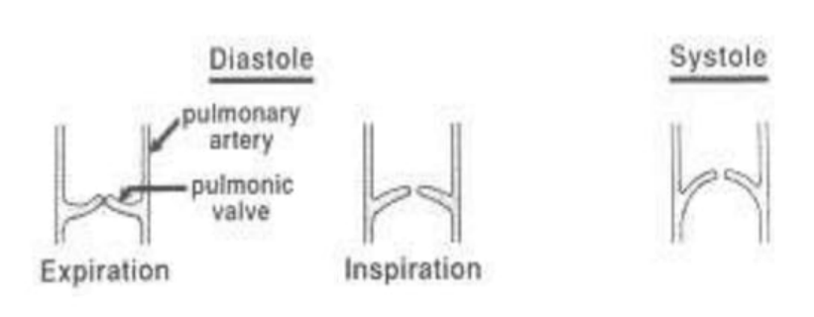
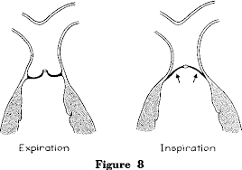
Inspiration
RVEDV Increase
RVEDP Increase
presystolic doming
- Attenuates the click
Pulmonary vascular Ejection Click may increase with inspiration

Slide 18
Aortic ejection sound:
LVEDP does not vary with respiration and it is never higher than the aortic diastolic pressure.
Aortic valvular ejection sound does not vary with respiration i.e. it is a constant Ejection Sound (constant click).
Aortic vascular ejection click may increase with expiration.
RVS3, RVS4 and TV OS accentuates during inspiration
LVS3, LVS4 and MV OS accentuates during expiration

Slide 19
Effect of Respiration on murmurs
All right sided murmurs are accentuated during inspiration including the TR murmur (Carvallo sign) due to the increased RV stroke volume.
Conversely, left sided murmurs are best heard during expiration.
Exception:
1)MR murmer doesnot vary with respiration
(Controversy)
2) In MVP- inspiratory decrease in LV size and LV Stroke Volume → increases the redundancy of mitral valve→ increases the degree of valvular prolapse→ result in louder and early occurrence of midsystolic click and a long duration MR.

Slide 20
MVP
Any maneuver which decrease LV size
Decrease - LVEDP
Early attainment- critical volume
Prolapse early in systole
Click moves closer to S1
Murmer becomes longer
During Inspiration – decrease in LV size and stroke volume

Slide 21
Murmers accentuated
Inspiration Expiration
TS MS
TR(Carvallos Sign) MR
PS(Mild-Moderate) AS
PR AR
VSD
Pericardial rub
What happens to Severe Pulmonary stenosis??
As the severity of PS increases→ Click comes closer to S1 (S1-Click)
During inspiration→ Click is soft and less appreciated (S1 alone is heared)
During expiration→ Click increases (S1 and Click togather is heared)
Intensity of S1 increase during expiration

Slide 22
No Change with respiration
(i) When a heart disease is complicated by RVF or Pulmonary HTN→ as their baseline RVEDP is high and there is no significant increase in the systemic venous return during inspiration.
But when these patients are auscultated in standing position (thus reducing the resting right heart filling), expected respiratory changes may be appreciated.
(ii) Aortic valvular Ejection Click: It does not vary with respiration.
(iii) MR murmur does not vary with respiration

Slide 23
RIVERO-CARVALLOS SIGN
Inspiratory accentuation of TR murmer
100% sensitive and 88% Specific for TR
Early systolic accentuation> Holosystolic accentuation
It may be absent if there is associated RVF or TS
MULLERS MANEUVER
Effects of inspiration on auscultatory findings can be increased by MULLERS MANEUVER.
Forced inspiration against closed glottis(Opposite of Valsalva)
Forcibly inspiring with mouth and nose sealed for about 10 sec.
What is reverse Carvallo Sign?? : Inspiratory attenuation of TR murmer → seen in RV HOCM
Inspiration → RV volume increase → RVOT Obstruction decreases→ More blood is emptied in to Pulmonary system → TR Murmer decreases

Slide 24
What happens to MS in Inspiration??—CONTROVERSY
Due to Pulmonary pooling of blood → LA receive less blood →LAP fall
So OS delays and Murmer shortens → Severe MS may behave as mild-Moderate MS
PSEUDO CARVALLO SIGN
During inspiration → LV SV reduces→ Reflex tachycardia → Shortens diastole → Flow rate increases
Increase in flow rate quadruples the gradient
Gradient across MV increase → Behave like severe MS

Slide 25
Summary of Respiratory variations

Slide 26
Postural change
Rapid standing can reduce venous return and thus reduce Cardiac output→ Reflex increase in HR and PVR.
As the patient goes from a recumbent to a sitting or standing position → there is diminished Intensity of all murmers that are originating from the right as well as the left heart
Except for those systolic murmurs of HOCM and MVP.

Slide 27
Sudden lying down from standing posture sudden passive elevation of both legs
Effects on heart sounds:
Widening of S2 split in both phases of respiration
Initially, RV S3 andS4 are accentuated and later after several cardiac cycles, LV S3 and S4 are accentuated
Effects on Murmers:
Due to increased stroke volume of both RV and LV, following systolic murmurs are augmented:
Systolic murmer of PS, AS
Systolic murmer of MR, TR
Systolic murmer of VSD
Functional systolic murmurs.

Slide 28
Passive V/S active Leg raising
Active leg raising → Will have elements of Valsalva and isometric exercise
Passive leg raising → Gravity dependent increase in venous return without any change in the intra thoracic pressure.
Hence the magnitude of changes may not be significant
It may be useful in patients with heart failure were complex dynamic auscultation is difficult.

Slide 29
Sudden standing from supine position sudden standing from squatting position
Rapid standing can reduce venous return and thus reduce Cardiac output → Reflex increase in HR and PVR.
Width of S2 splitting reduces
Diminished RVS3,RVS4,LVS3,LVS4
Semilunar Valve Stenotic murmers, AV valve regurgitation murmers and flow murmers will attenuate.
Up on standing from supine position:
Venous return to heart decreases → Attenuation of all right sided events
Except Pulmonary ejection click of valvular PS

Slide 30
Physiology of Squatting
Increase of splanchnic venous return due to abdominal compression
Increase of systemic vascular resistance due to the kinking of iliac and femoral arteries
Increase of systemic arterial pressure/central aortic pressure with a transient reflex bradycardia.
Increase in Venous return> Increase in Vascular resistance> Bradycardia
All Cardiac events get accentuated Except HOCM, MVP and Ejection Click of Valvular PS
Due to simultaneous elevation of Central Aortic pressures → Its influence on AS events may not be that promising

Slide 31
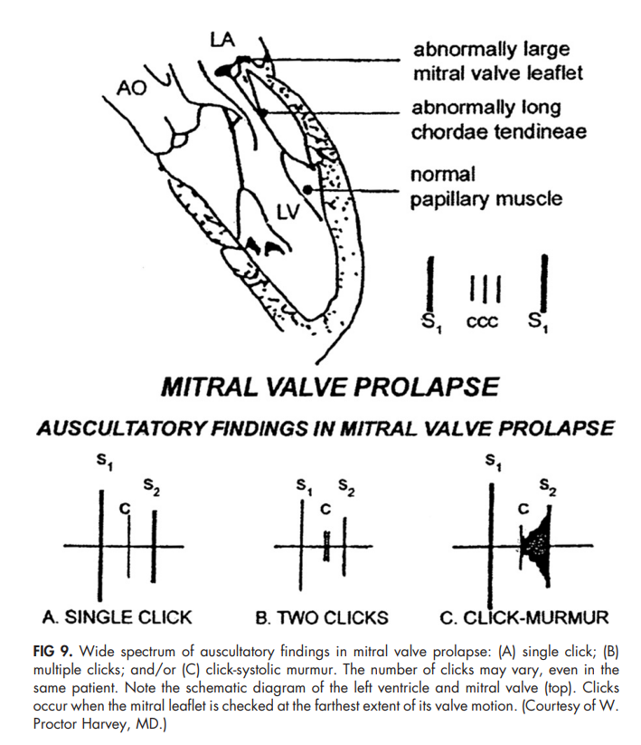
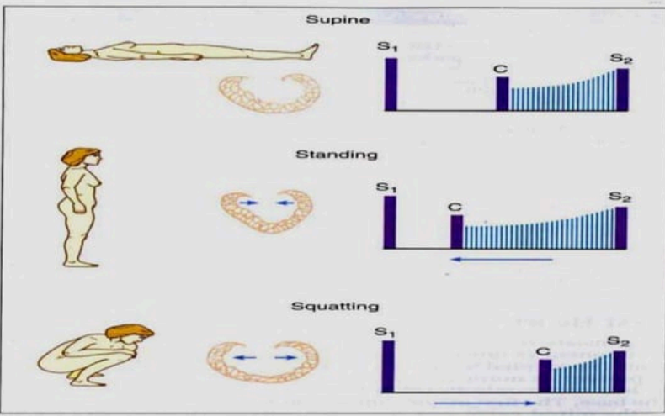
Mitral Valve Prolapse
In MVP, due to the redundancy of the valve, prolapse of MV in to LA increases when ventricular volume(LV EDV) and LV size decreases.
Early occurrance of Mid systolic click and Late systolic murmer
When ventricular volume(LV EDV) increases, prolapse decreases
Delayed occurrence of Mid systolic click and Late systolic murmer

Slide 32
HOCM
Physiological changes that increase LVOTO are
1)Reduction in LV size
2)Reflex inotropic stimulation by increased catecholamine release
When LV Size (LV EDV) decreases and force of contraction increases→ LVOTO incerase → Intensity of Systolic Murmer increases
When LV Size Increases and force of contraction decreases→ LVOTO decrease → Intensity of Systolic Murmer decreases

Slide 33
DURING SQUATTING

Slide 34
What happens to TOF while Squatting
Due to elevated systemic vascular resistance→ Aorta offers more resistance to RV →Right to Left shunt is decreases→ Pulmonary blood flow increases → RVOT Murmer increases.
Abdominal compression will push more saturated Splanchnic venous blood on to Right heart.
There is immediate improvement in arterial oxygen saturation and thereby alleviates the symptoms.

Slide 35
Left lateral recumbent position brings the heart closer to the chest wall.
Accentuates S1, LV S3 and S4, and mitral OS.
Accentuates MDM of MS, Austin Flint murmur of AR and SM of MR.
Sitting up and leaning forward positions causes more closeness of the base of the heart to the chest wall.
Loud P2 and split S2 are more clearly audible.
Similarly EDM of AR and PR are more readily audible.
Knee-elbow position brings the heart close to the chest wall.
Pericardial rub becomes more prominent due to increased friction between parietal and visceral pericardial layers.

Slide 37
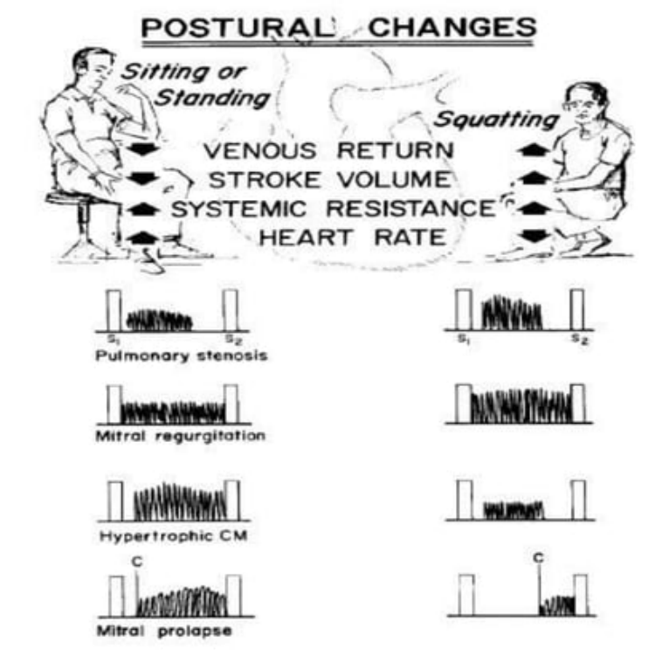

Slide 38
Valsalva maneuver
It was initially described in 1704 as a method for expelling pus from the middle ear by straining with mouth and nose closed.
Deep inspiration followed by forced expiration against a closed glottis for 10–20 s
or
Blowing into a BP manometer to maintain a level of 40mmHg for 15 secs.
The normal response to the Valsalva maneuver consists of four phases

Slide 39
Mechanical and reflex changes depend on
1. level of cardiac function and effective central blood volume
2. speed and magnitude of baroreceptor responses to change in arterial pressure

Slide 40
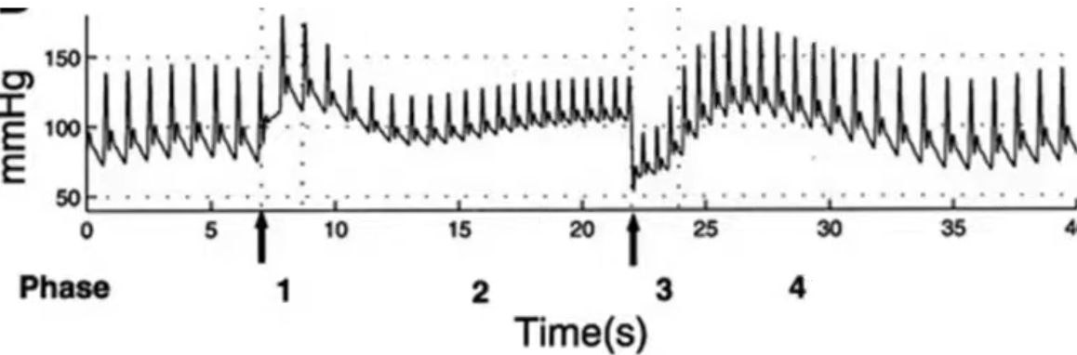
Phase I: Up on straining → Intra thoracic pressure increases (40mmhg)
Transfer of the intrathoracic pressure on to all cardiac chambers and intrathoracic structures (Including Aorta)
Passive raise in BP from 120/80→160/120
Lung squeeze the pulmonary venous blood on to left heart → mild increase in LV SV
Changes in Pulse pressure and HR are insignificant
Phase 1 has no involvement of autonomic nervous system (Purely mechanical)
It is hemodynamically insignificant

Slide 41
Phase II: Sutained intrathoracic pressure (40mmhg) for 15 sec
(Venacavo atrial gardient decreases)
Decrease in systemic venous return and stroke volume (initially right side followed by left side)
Decrease of systolic and pulse pressures (small pulse)
Reflex tachycardia→ Sympathetic response
All cardiac events are attenuated except MVP and HOCM

Slide 43
Phase III (cessation of straining phase)
BP drops by 40mmhg
Drop in intarthoracic pressure→Increased venacavo atrial gradient + Increased tone of Venous system (Sympathetic response) →Rapid filling of heart
Changes in Pulse pressure and HR are insignificant
Phase 3 (like phase 1) also has no involvement of autonomic nervous system (Purely mechanical)

Slide 44
Phase IV (overshoot phase) consists of return of the events to pre Valsalva levels after 6–8 beats.
Due to increased venous return→ Force of contraction increases
Due to increased vascular tone→SVR is high(sympathetic response of phase 2)
BP over shoots the base line
Vagal response comes in to action→ Reflex bradycardia and Pulse pressure widens

Slide 45
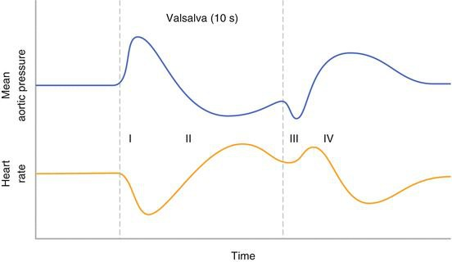
Phase I and III are not usually perceptible at bedside.
Since coronary blood flow transiently falls during this maneuver, it should not be performed in patients with ischemic heart disease

Slide 46
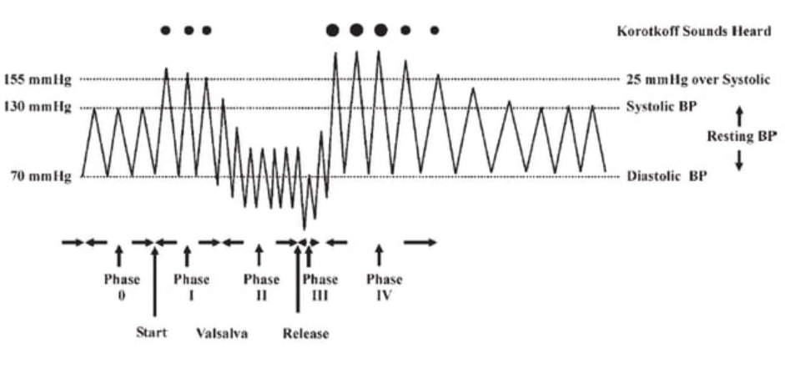
 | PHASE 1 | PHASE2 | PHASE3 | PHASE 4
Venous return | Decrease | Decrease | Increase | Increase
Mechanism | Mechanical | Reflex(Sympathetic) | Mechanical | Reflex(Para sympathetic)
HR | No change | Tachycardia | No change | Bradycardia
Pulse pressure | No change | Narrows | No change | Widens

Slide 47
VALSALVA | HEART RATE | BLOOD PRESSURE | MECHANISM
Phase I Onset of strain | No change | Increases | Increased intrathoracic pressure compresses vessels within thorax producing abrupt increase in arterial pressure
Phase II Maintenance of strain | Increases | Systolic and Pulse pressure decreases | Followed by reduced venous return to right atrium leading to decreased cardiac output and systolic pressure. Carotid baroreceptors inhibit vagus nerve and stimulate vasomotor center. Reflex tachycardia and peripheral vasoconstriction result.
Phase III Release of strain | No change | Further decrease in blood pressure | Venous return and capacity of pulmonary bed increase abruptly. Arterial pressure further diminishes due to pooling in expanded pulmonary bed
Phase IV Relaxation | Decrease | Overshoot of systolic pressure & pulse pressure increase | Accumulated venous return reaches left ventricle and increased stroke volume is pumped into constricted systemic vascular bed causing overshoot of arterial pressure. This overshoot is detected by the carotid sinuses resulting in excitatory effect on vagus nerve leading to reflex bradycardia

Slide 48
During phase2- split narrows and all cardiac events(Except MVP and HOCM) are attenuated.
Up on release of valsalva- Right sided murmers come back to baseline intensity with in 2-3 cycles where as it takes 5-10 cycles for left sided murmers to come back to baseline intensity.
Phase 3: Split widens and right sided murmers return back to baseline
Phase 4: Left sided murmers returning back to baseline intensity

Slide 49
Practically what we look for while doing Valsalva Maneuver
Phase 2 : Is used to distinguish systolic murmur of fixed vs dynamic LVOT obstruction. (HOCM vs AS).
Most other murmurs decrease in intensity
Phase 4 : used to distinguish left sided from right sided murmurs
Right sided murmurs that decrease during phase 2 return to baseline intensity immediately after valsalva release.
Left sided murmurs require five to ten cardiac cycles to return to baseline

Slide 50
VALSALVA INDEX
Maximum HR(Phase2)/Minimum HR(Phase4)
Normal >1.4
Assesses Sympathetic system
Longest RR(Phase4)/ Shortest RR(Phase 2)
Normal >1.2
Assesses Parasympathetic system

Slide 51
Square wave response
Seen in situations were you cannot modify ventricular volume(CHF, ASD, CP, MS with PAH)
Phases I and III responses are normal(Mechanical)
Since there is no change in SV, baroreceptor stimulation doesnot happen→ No autonomic stimulation
.

Slide 52
Persistent elevation of systolic and diastolic pressure with no change in heart rate.
There is no overshoot of blood pressure and no bradycardia when straining is stopped.
Absence of bradycardia at the end of proceduce is the easiest sign to detect

Slide 54
Muller maneuver
The Muller’s maneuver is the converse of the Valsalva maneuver.
It consists of forced inspiration against closed glottis i.e. with closed nose and firmly sealed mouth for about 10 s.
As this maneuver exaggerates the inspiratory effort →Reduced intrathoracic pressure→ Venous return increases
S2 split is widened, RV S3 and S4 are accentuated
All right sided murmurs are augmented
This maneuver cause Increase in pulmonary artery flow with decrease in pulmonary venous pressure
Augments the continuous murmer of Pulmonary AVF

Slide 56
Isometric exercise
It is done by sustained handgrip (Isometric handgrip exercise)
1.Ideally by using calibrated handgrip device simultaneously by both hands
2. By pressing a hand ball simultaneously with both hands
3. By simply making a hand grip with both hands simultaneously
4.Apply BP cuff on both arms and inflate it to 20mm above SBP
Sustained the for 20–30 s and It should be simultaneously done by both hands
Inadvertently doing Valsalva maneuver during handgrip must be avoided
It should be avoided in patients with ventricular arrhythmias and myocardial ischemia

Slide 57
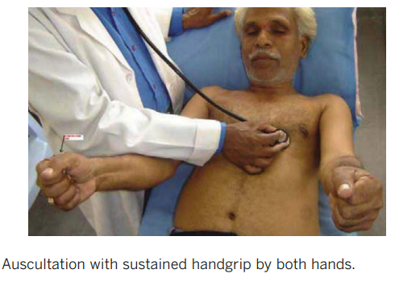
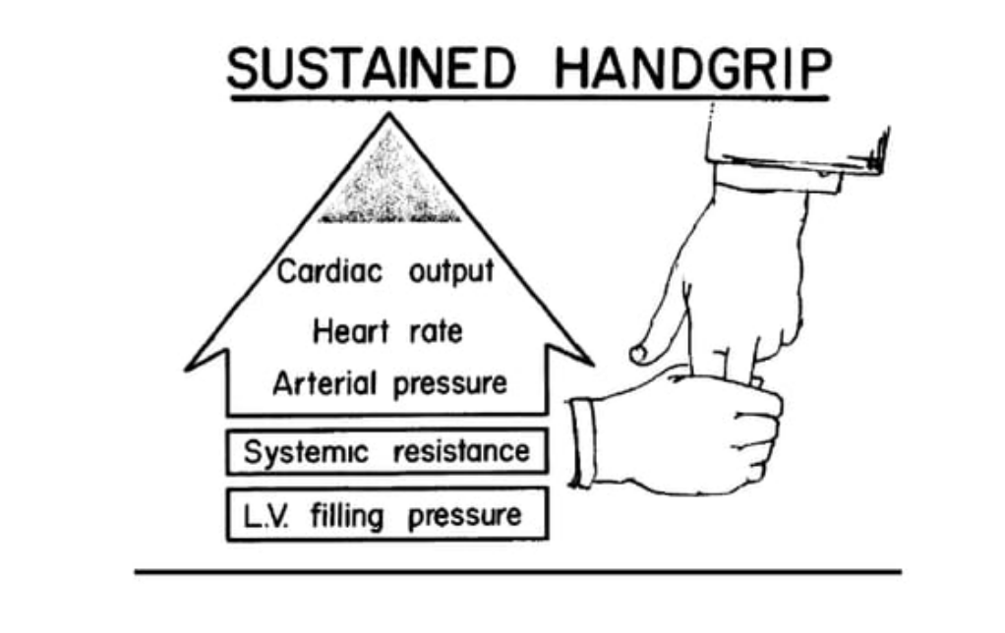
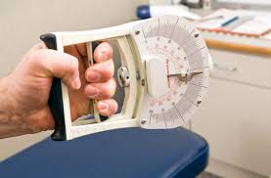

Slide 58
Physiological effects
Isometric handgrip results in transient but significant increase in sympathetic discharge
● Systemic vascular resistance (SVR)
●Cardiac output
●Heart rate
● Arterial pressure (BP)
● LV filling pressure and size
It mimics a hyperdynamic circulation
All the left sided events increase
Except MVP, HOCM, AS

Slide 59
Effects on the murmurs
Murmer of AS is diminished as a result of reduction of pressure gradient across the aortic valve due to an increase in arterial pressure and SVR
As a result of increased LV volume and size
a)Systolic murmer of HOCM diminishes
b)Mid systolic click and late Systolic murmer of MVP are delayed due to decrease in prolapse
Diastolic Murmer of MS becomes louder due to the increased cardiac output
Accentuation of murmers of AR and MR and VSD due to increased systemic vascular resistance.

Slide 60
Clinical importance-AS V/S MR
AS murmer decreases and MR murmer increases as SVR is increased

Slide 62
Changes in cardiac cycle length due to arrhythmias
VPC and Atrial fibrillation
During the compensatory pause that follows a VPC or following a longer cycle lengths in atrial fibrillation, there is
An increase in the ventricular filling and ventricular size
There is secondary augmentation of ventricular contractility of during next beat and transient elevation of the arterial pressure.
The same observations may be made during transient slowing of the sinus rate by light carotid sinus pressure

Slide 63
Effects of cycle length changes on murmurs:
Systolic murmer of AS and PS accentuate due to increased ventricular filling and contractility.
EDM of AR becomes louder due to transient elevation in the arterial pressure
In HOCM→Following ectopic→ Ventricular filling is more→ cavity size is more
But the force of contraction increases→Net gradient increases→ Intensity of murmer increase.
Mid systolic click and late Systolic murmer of MVP are delayed because of decreased prolapse due to increase in ventricular filling and LV size.
No change is seen in Systolic murmer of MR and VSD

Slide 64
Can be used to differentiate AS murmer from MR murmer

Slide 65
AF in MS:
When the cycle length changes→ Atrial pressure is also changing
In a short cycle→ diastole is short→ LA emptying is less→ Cycle ends with a higher LAP→ Next cycle behaves like Severe MS(Short A2 OS interval and long duration murmer)
Reverse happens in a long cycle.
Systolic murmer of AS V/S HOCM
Following ectopic→ long cycle→ Ventricular filling is more→ Size is more
Similarly the force of contraction increases→Net gradient increases→ Intensity of murmer increase.
In AS→ Obstruction is fixed→ Volume increases→ Force of contraction increases→ Murmer increases

Slide 67
Pharmacological agents
Amyl nitrate inhalation: It is done by Placing amyl nitrate on a piece of gauze and asking the patient to take three or four deep breaths over 10–15 s.
Physiological changes
It induces marked vasodilatation with the reduction of systemic arterial pressure in first 30 s.(Reduces SVR and BP)
It is followed by reflex tachycardia, increase in cardiac output and velocity of blood flow after 30–60 s
Major auscultatory changes occur in the first 30 s after inhalation

Slide 68
Due to fall in SVR, following murmurs are diminished:
Systolic murmer of MR and VSD
EDM and Austin Flint murmur of AR
Diastolic phase of continuous murmur of PDA
Systolic murmer of TOF decreases
Reduction in SVR→ Resistance of RV to Aorta decrease→ Emplties more blood in to Aorta→ Reduction in PBF→ RVOT murmer decreases.
All other murmers (AS, PS, MS, TS, TR, PR) are augmented as CO and flow rate is increasing
S3 of either ventricle is augmented due to rapid ventricular filling, but S3 of MR origin diminishes.

Slide 69
Due to decreased LV volume and size (Low SVR- Free emptying of blood).
LVOTO increases and murmer of HOCM is accentuated.
The degree of prolapse increases in MVP, and there is an early onset of mid systolic click and murmer.
Though presently amyl nitrate inhalation at the bedside is not routinely practiced, its response is useful in distinguishing most of the common murmurs
AUGMENTED | DIMINISHED
ESM of PS | RVOT murmer of TOF
Systolic murmer of AS | Systolic murmer of MR
PSM of TR | PSM of MR
MDM of MS | MDM of AR (Austin Flint Murmer)
EDM of PR | EDM of AR

Slide 70
Methoxamine and Phenylephrine:
These vasopressor drugs are less commonly used because of the inconvenience of intravenous administration and greater care needed in titrating these drugs to achieve the desired effect.
Methods :
3–5 mg of methoxamine IV is administered which elevates arterial pressure by 20–40 mmHg for 10–20 min.
But 0.3–0.5 mg of phenylephrine IV is preferred as it elevates the arterial pressure by 30 mmHg for only 3–5 min.
Physiological response and effects on heart murmers is opposite to that of amyl nitrate inhalation.
Since these drugs increases arterial pressure, causes reflex bradycardia and decreased contractility and decrease cardiac output, they should not be used in patients with Heart Failure and Hypertension

Slide 73
Summary of dynamic auscultation
1)All murmers decrease with standing and Valsalva(Decreased VR and CO) except MVP and HOCM
2)All the murmers increase with Squatting(Increase VR and CO) except MVP and HOCM
3)All right sided murmers increase with Inspiration
4)All left sided murmers decrease with inspiration except MVP and HOCM
5)Murmer of MVP and HOCM decrease with Squatting and Hand grip
6)Murmer of HOCM increase post VPC but MVP decrease post VPC

Slide 74
Mitral stenosis
Inspiration Standing Up
Pulmonary venous return decreases
LAP decrease
MDM reduced
OS softens
A2-OS widens
A2-P2-OS audible (3sequential sounds)
Exersise/Hand grip
Amylnitrate/Squatting
HR, CO and Flow rate increases
MDMaccentuated
Valsalva shows Square wave response

Slide 75
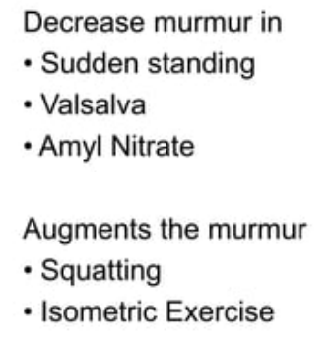
Mitral regurgitation
MR murmer show no respiratory variation
MR murmer donot vary with cycle length changes
Isometric exercise
SVR and CO increase
Augments murmer
Amyl nitrite
SVR decrease
Attenuate murmer

Slide 76
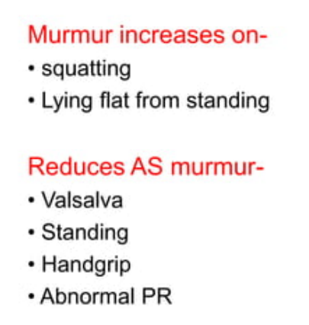
Aortic stenosis
All Left sided murmers increase with isometric hand grip
Except MVP, HOCM and AS
Post PVC beat
Filling and contractility increases
Gradient increase
Augments murmer
Hand grip
SVR Increase
Gradient decreases
Diminishes murmer

Slide 77
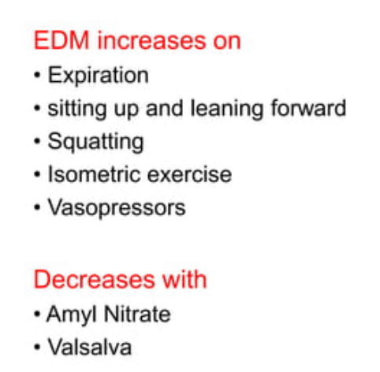
Aortic regurgitation
Isometric exercise
SVR and CO increase
Augments murmer
Amyl nitrite
SVR decrease
Attenuate murmer

Slide 78
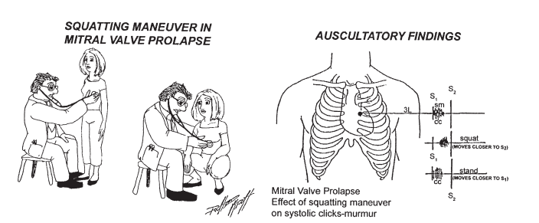
MVP
Standing and valsalva
LV volume decreased
Earlier Click and long murmer
Squatting, Post ectopic, Isometric exercise
LV volume increased
Late click and short murmer

Slide 80
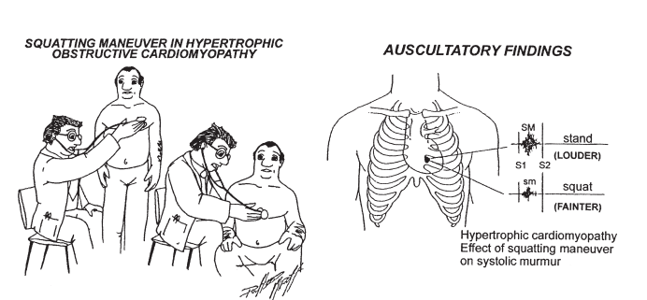
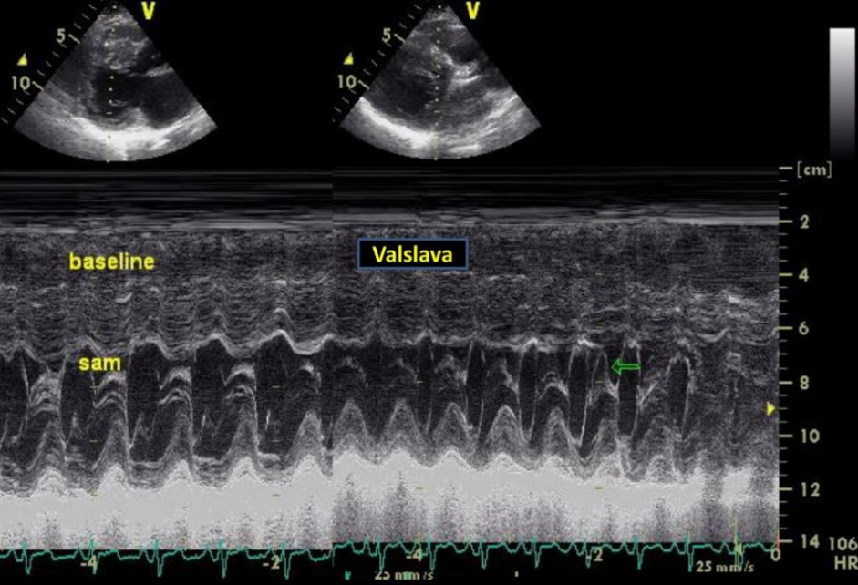
HOCM
Valsalva
Standing
Post ectopic
Amyl nitrate
Murmer augments
Squatting
Isometric handgrip
Penylephrine/Methoxamine
Diminishes murmer

Slide 81
VALSALVA STRAIN FOLLOWING AMYL NITRATE IN HOCM
20-30% of HOCM fail to show augmentation following Valsava strain.
In such cases, if Valsalva strain is repeated ater Amyl nitrate inhalation, augmentation of Systolic murmer may be seen.
This maneuver increases the sensitivity of Valsalva to diagnose HOCM

Slide 83
S4-S1 V/S SPLIT S1 V/S S1-Aortic Ejection Click
Maneuver | S4-S1 | Split S1 | S1-AEC
Respiration | S4 Louder in Expiration | Obvious in Inspiration | No change with respiration
Sudden Standing | S4 softens and move closer to S1 | Becomes single | Gap widens but no change in intensity
Lying down with passive leg raising | S4 becomes louder and move away from S1 | Becomes wider | No change
S2-OS V/S SPLIT S2
MANEUVER | S2-OS | SPLIT S2
Respiration | OS softens & Heared as Triple sound sometimes during inspiration | S2 Split Widens during Inspiration
Sudden Standing | S2 OS gap Widens | S2 Split Narrows

Slide 84
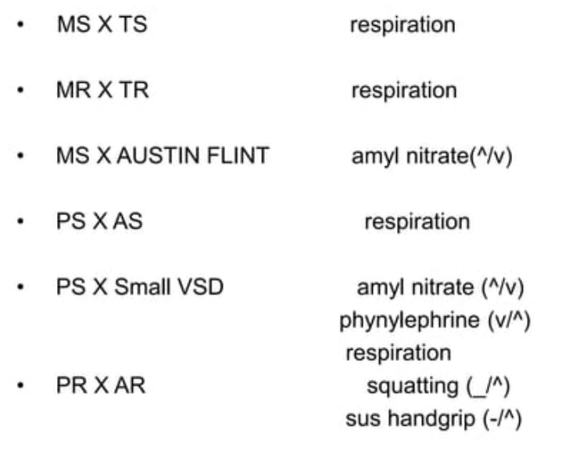

Slide 88
QUIZ!!→ IDENTIFY THESE SYSTOLIC MURMERS?

Slide 90
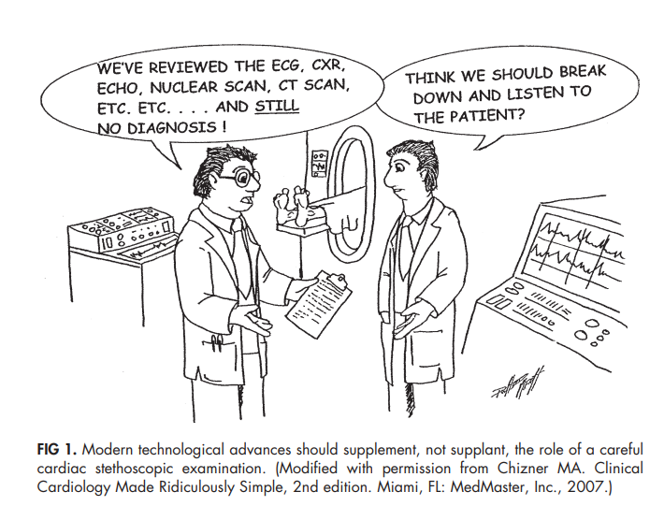
THANK YOU!

